Slide 1
Taxation of Shares and Securities
CA Deepak K. Raut

Slide 2
Why This Session
Rising Public Participation: Financial and tax related guidance is needed to everyone.
Complex Tax Structures: involves multiple rules which are challenging to understand without professional advice.
Maximizing Returns Through Tax Planning: Effective tax planning ensures better wealth management and helps in avoiding unnecessary tax liabilities.
Compliance is Key: Timely compliance is crucial.
Strategic Investment Decisions: Knowledge of taxation impacts investment decisions, helping investors choose the right instruments.

Slide 3
Agenda:
Taxation of Gains – Long Term & Short Term
Taxation as Business Income – Speculative & Non-Speculative
Set off and carry forward of losses
Taxation related to various instruments including VDA
Taxation of Buyback transactions
Other Misc. Aspects

Slide 4
Dividends:
Dividend of shares & mutual funds units
W.e.f. 01/04/2020 erstwhile DDT was abolished, consequently dividend income made taxable in the hands of shareholders by withdrawing section 10(34).
Deduction of interest only, to the extent of 20% of income received
Liable for TDS u/s. 194

Slide 5
Capital Gains:
Profit arising from the transfer of a Capital Asset.
Term ‘Capital Asset' has been defined in Section 2(14)
Classification of Capital Gains:
1. Short-Term Capital Gains (STCG)
2. Long-Term Capital Gains (LTCG)
such classification is done on the basis Holding Period.
Loss Carry Forward: LTCL Against LTCG only STCL Against LTCG/STCG can be carried forward for 8 assessment years

Slide 6
Holding Period:
w.e.f. FY 2024-25, for classifying LT & ST, there will be only 2 holding period 12 Months & 24 Months. The 36-month holding period has been removed.
Following assets, if held for more than 12 months, then long-term capital asset:
1. Shares listed on a recognized stock exchange in India
2. Other Securities listed on a recognized stock exchange (like debentures, bonds, govt securities, Gold funds, ETFs, REITs, INVITs, etc.)
4. Units of equity oriented mutual fund
5. Zero coupon bonds
Assets other than above, if held for more than 24 Months, then Long-term capital asset

Slide 7
Trading vs. Investing
Circular No. 6, dated 29-02-2016 & Circular No. 4, dated 15-06-2007
Circular is helpful to decide whether to tax profit as Business income or Capital Gain.
circular applicable for profit from listed shares only and option once exercised assessee not allowed to change stand again.
Treatment in books, Motive of purchase, nature & recurrence of transactions to be considered while deciding.
If assessee exercises the option to shows profit as Business Income, then Profit is taxed under the head Income from Business or Profession slab rate.
Otherwise, profit will changeable under the Capital Gains head.

Slide 8
Intraday Trading
Categorized as Profits and Gains from Business & Profession.
Treated as speculative business income since no intention to take delivery.
Audit Applicability – upto 10 Cr. (95% transactions in digital mode) 44AD Available
Loss Carry Forward: Speculative Business Loss C/f only Up to 4 years. Offset against speculative business income only. Losses cannot be C/f if opted for New Tax Regime.

Slide 9
Futures & Options:
F&O is classified as business activity.
Based on calculated turnover Tax Audit applicability will be decided.
Futures Turnover = Absolute Profit (Sum of Profit and Loss on all transactions)
According to the 8th edition of Guidance Note Options Turnover = Absolute Profit (Sum of Profit and Loss on all transactions)
Audit Applicability – upto 10 Cr. (95% transactions in digital mode) 44AD Available
Loss Carry Forward: Business Loss C/f Up to 8 years. Offset against non-speculative business income only.

Slide 10
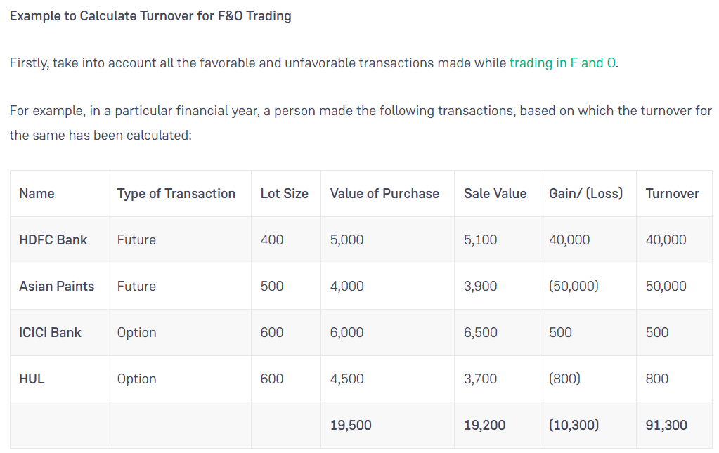
Turnover Calculation:

Slide 11
Shares Buyback:
It is not Transfer of shares it is Extinguishment of shares
W.e.f. 01/10/2024 erstwhile section 115QA was abolished, consequently amount received on buyback made taxable in the hands of shareholders by withdrawing section 10(34A).
Amount received is taxable as dividend income, Deduction of Cost of acquisition not allowed
COA of shares bought back is allowed as loss under capital gain head
Liable for TDS u/s. 194 as regular dividend

Slide 12
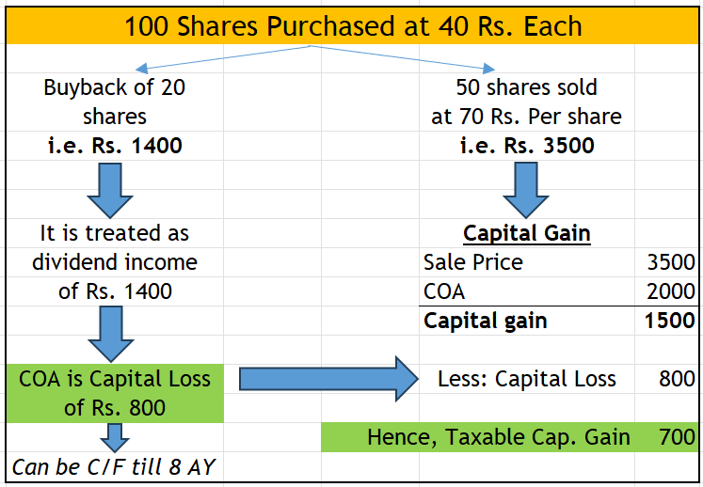
Shares Buyback:
Illustration:

Slide 13
Cryptocurrencies/NFT/VDA:
Section 2(47A) was added to the Act to define it
Flat 30% Tax
No any deduction other than COA
No difference in LT, ST or Trading or Investing
Separate section in ITR to report Gains from VDA
Section 115BBH
Loss of one VDA can not be set off against another VDA
No Loss set off with any other income
No Loss C/f
194S – 1% TDS on transfer
Added in ‘Property’ definition of Sec. 56(2)(x)

Slide 14
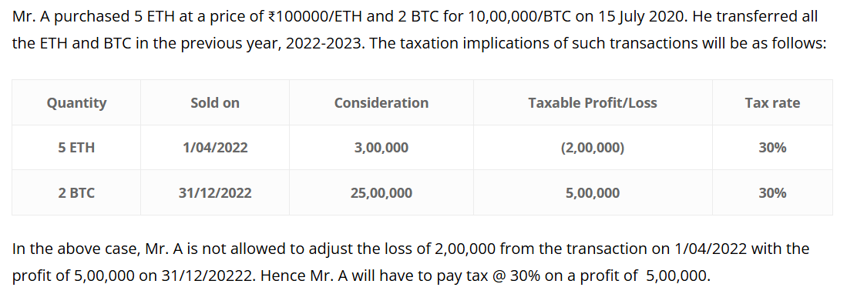
Cryptocurrencies/NFT/VDA:
Example of Cryptocurrency tax computation:

Slide 15
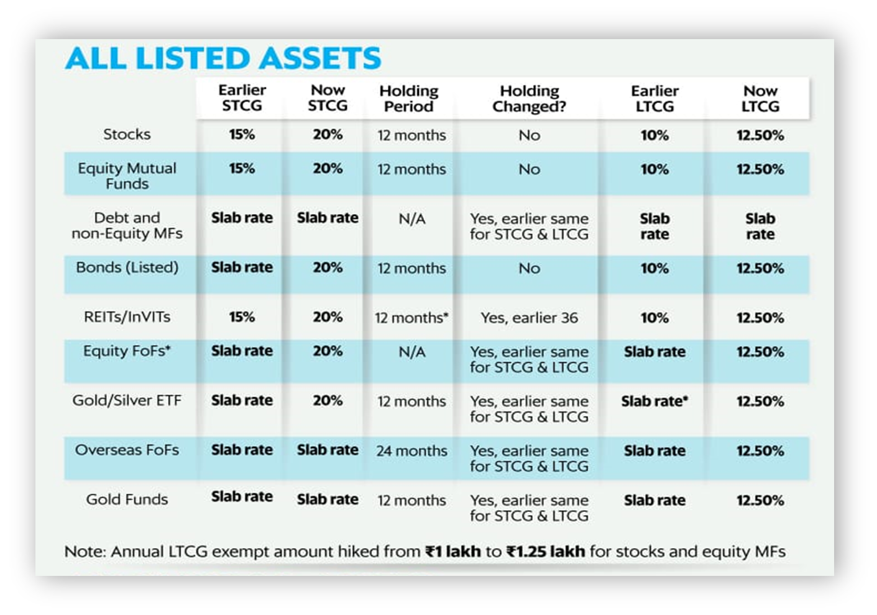
Taxability:

Slide 16
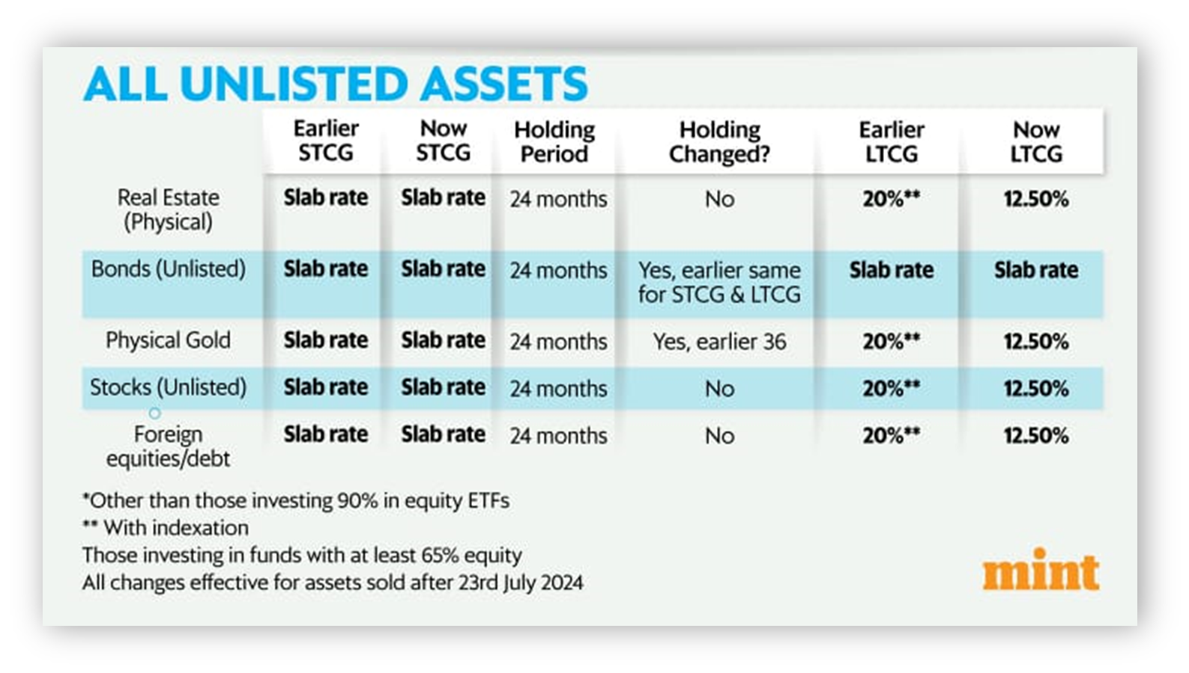
Taxability:

Slide 17
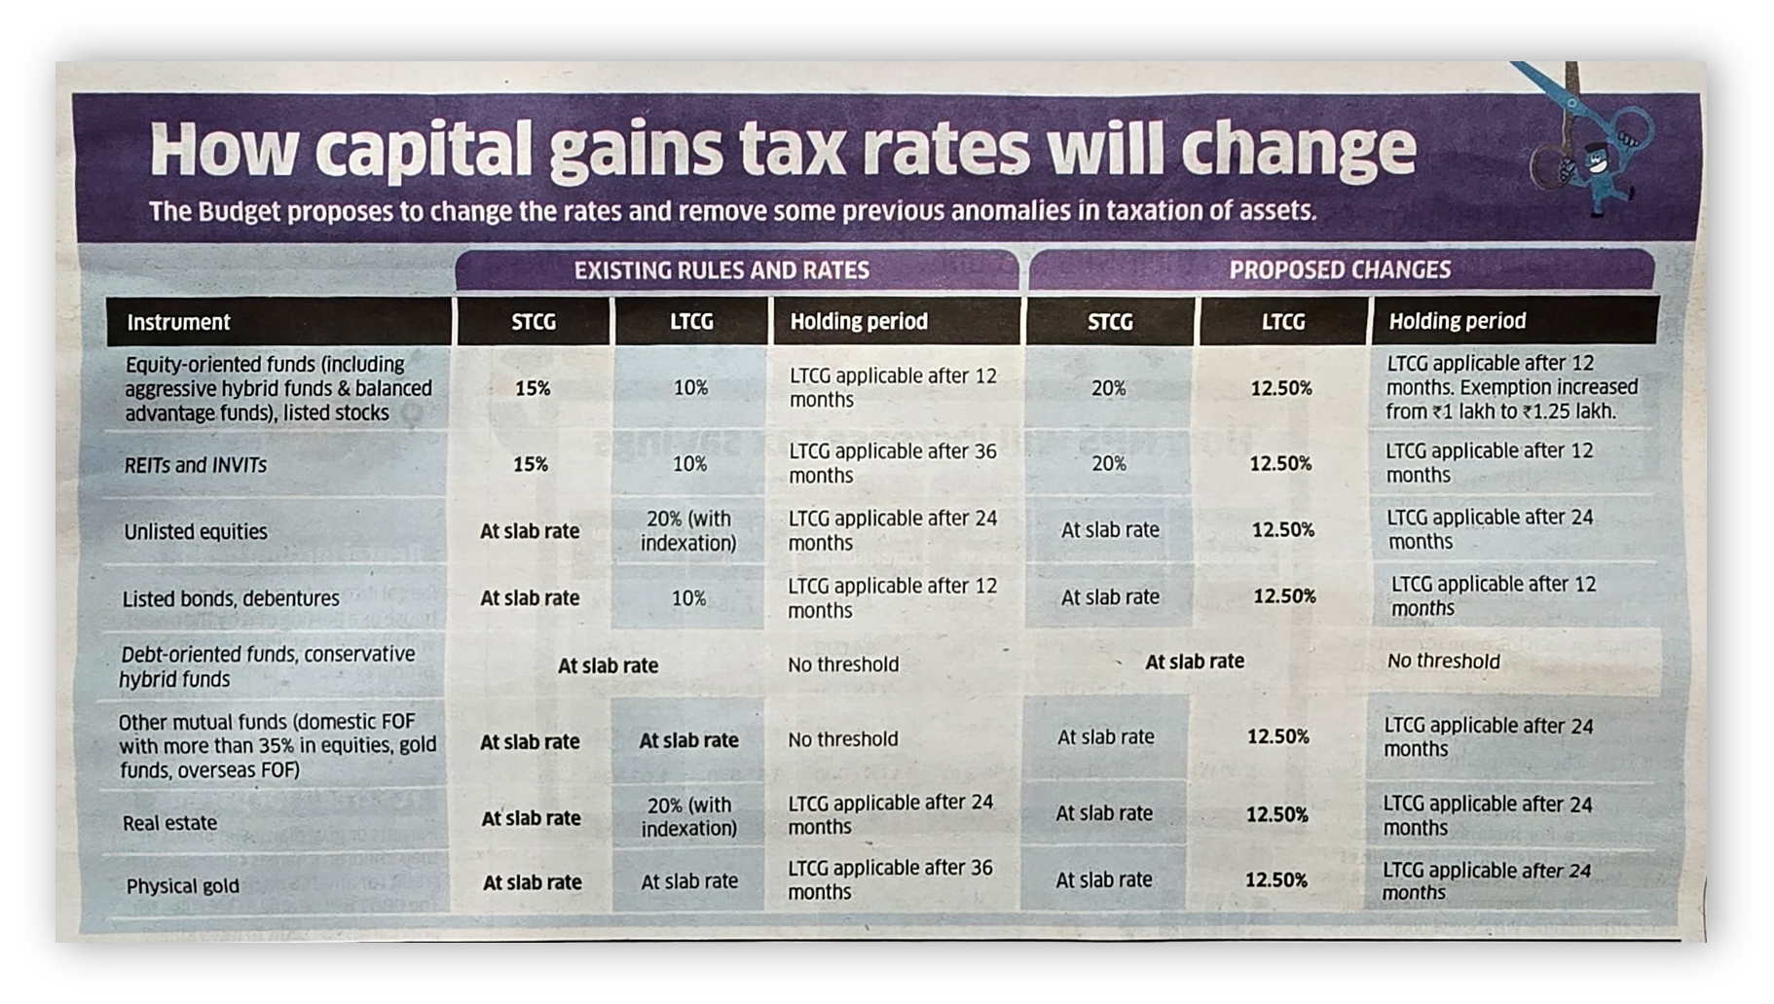
Taxability:

Slide 18
Thank You All..!!
- CA Deepak K. Raut

